Slide 1
Great Outdoors Group-B
By
Ayush Agrawal

Slide 2
Epic And User Story
Initialize Return Order
Validate And Check
Purpose Of Return
Confirmation of Return
Generate Return Id
Generating Return Reports
Return Online Order

Slide 3
Epic And User Story
Adding, Updating , Deleting Sales Person Details
Generating Sales Person Id
Generating Sales Person Target Report
Sales Person Details

Slide 4
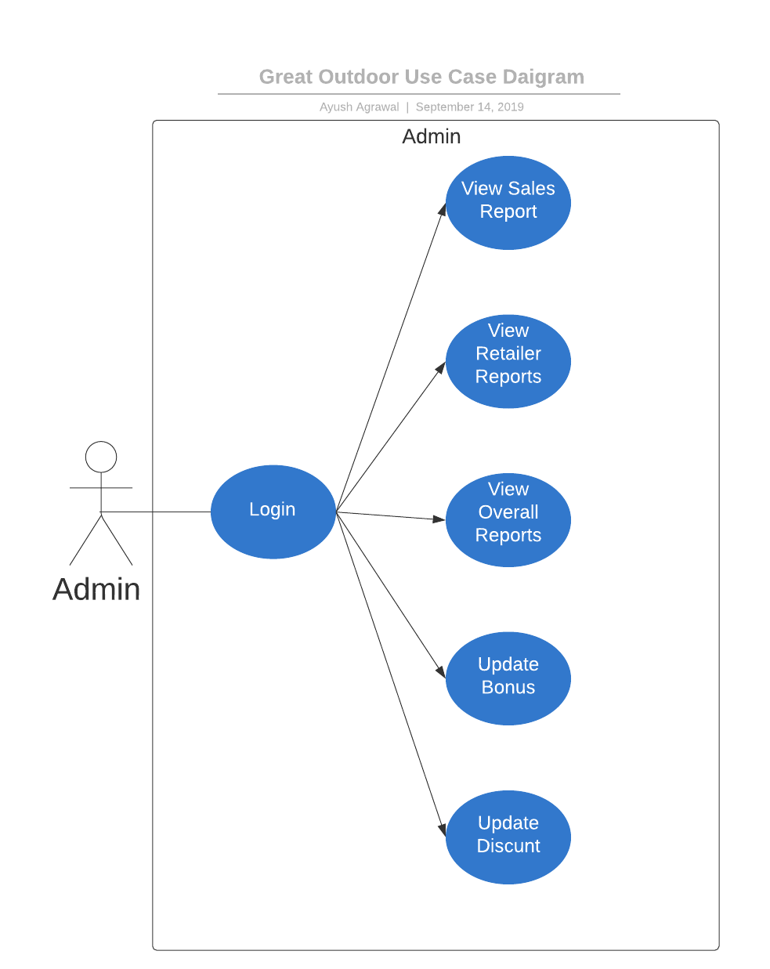
Use Case Diagram

Slide 5
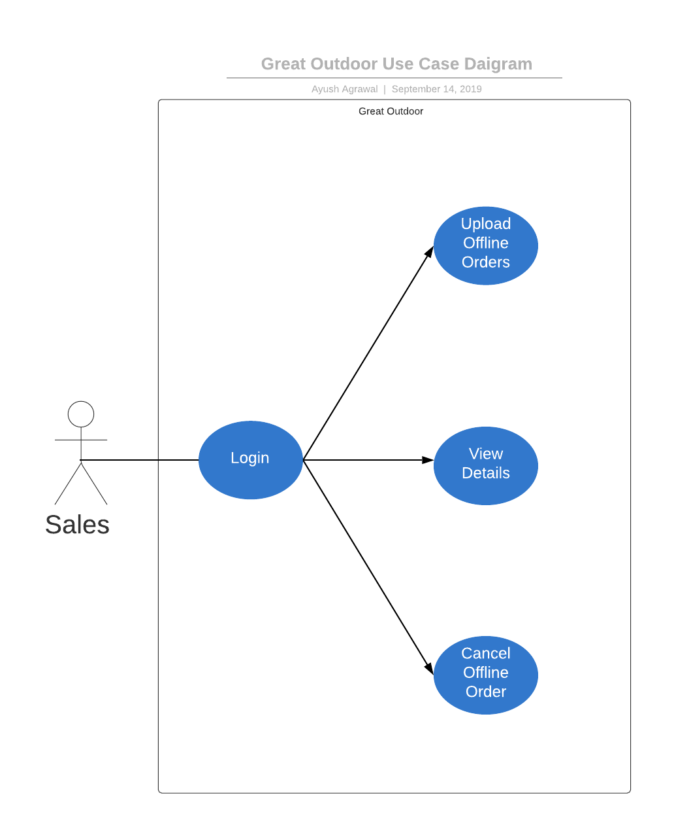
Use Case Diagram

Slide 6
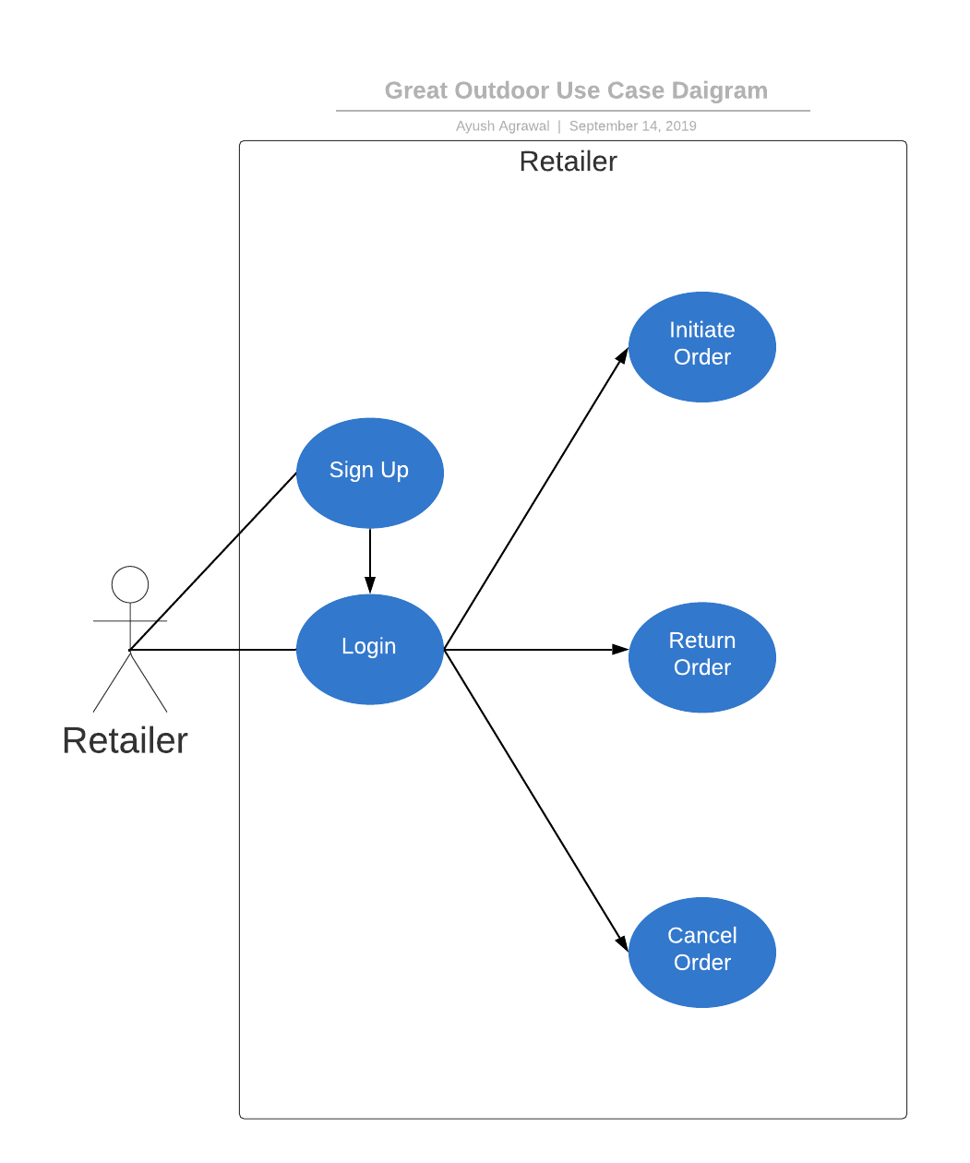
Use Case Diagram

Slide 7
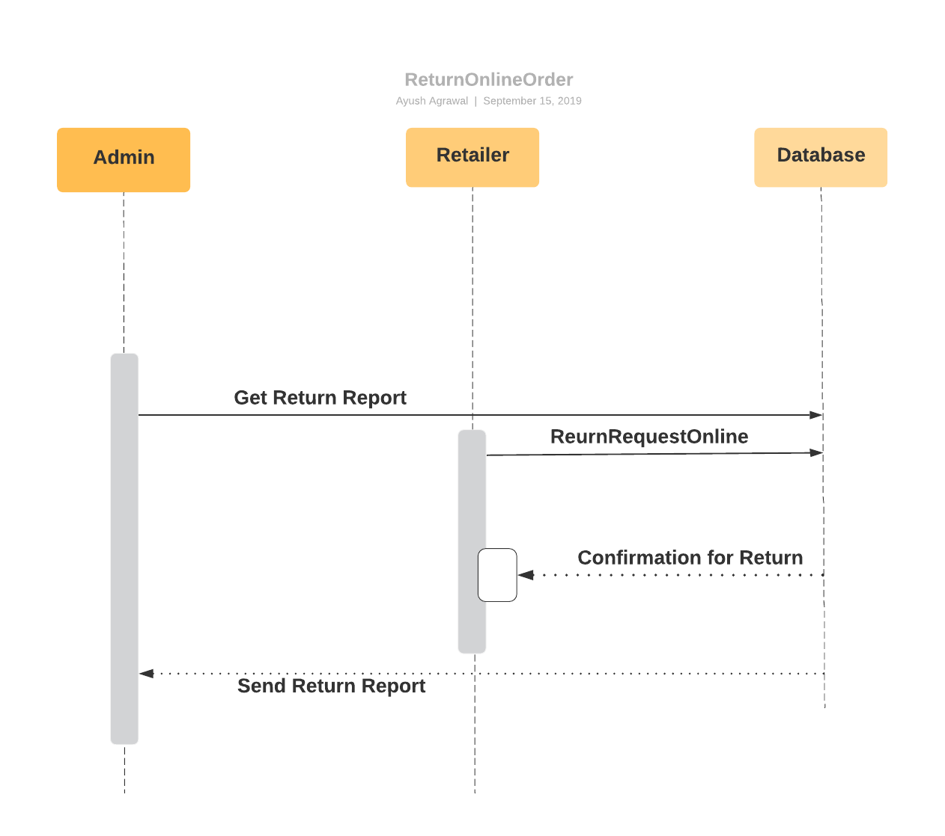
Sequence Diagram For Online Return Order

Slide 8
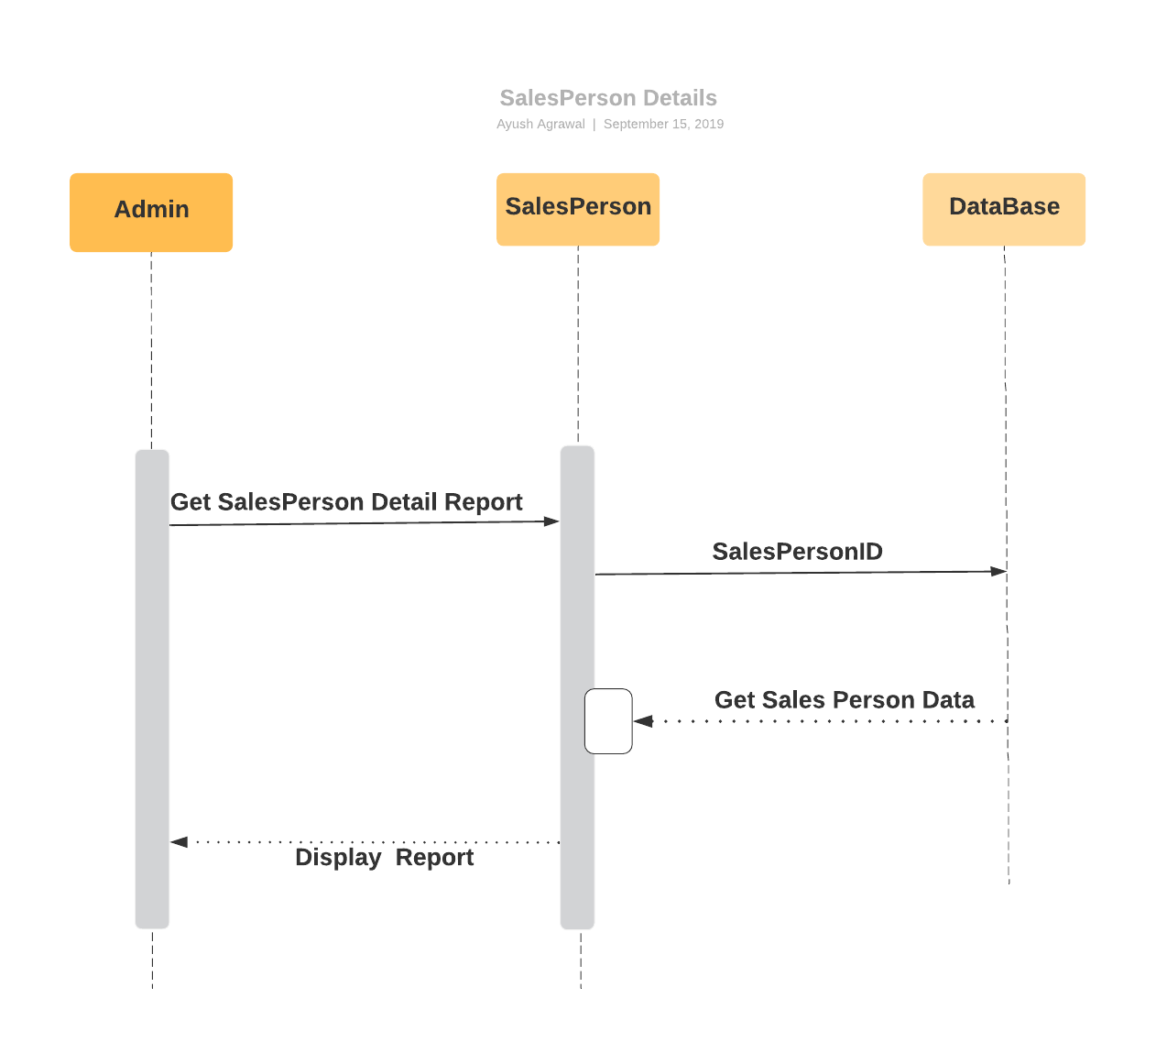
Sequence Diagram for Sales Person Details

Slide 9
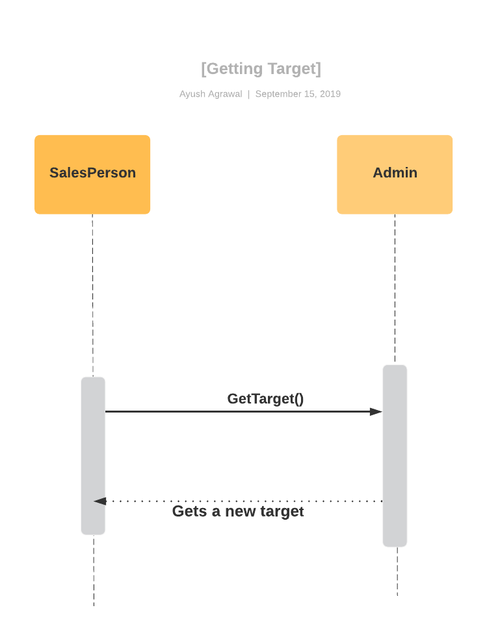
Sequence Diagram For Getting Sales Target By Sales Representatives

Slide 10
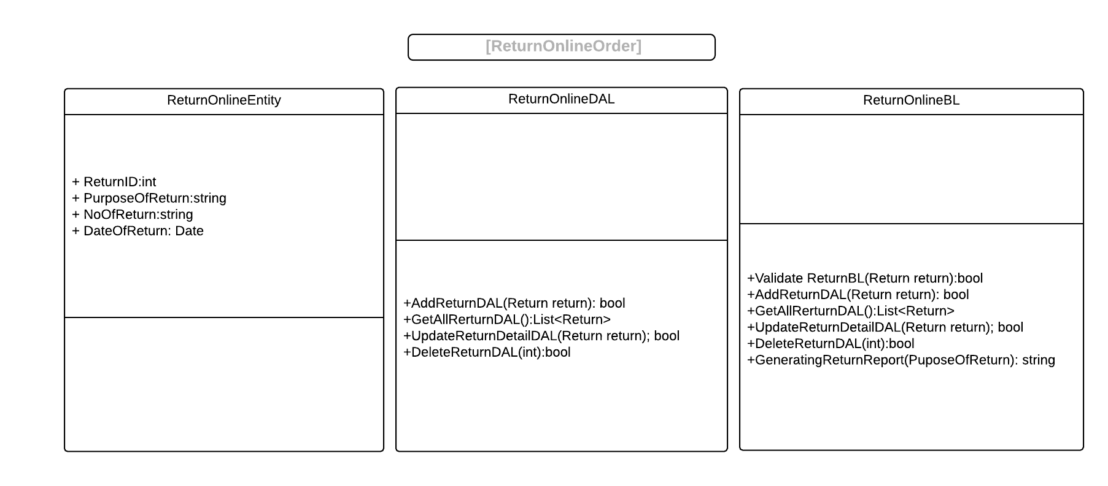
Class Diagram

Slide 11
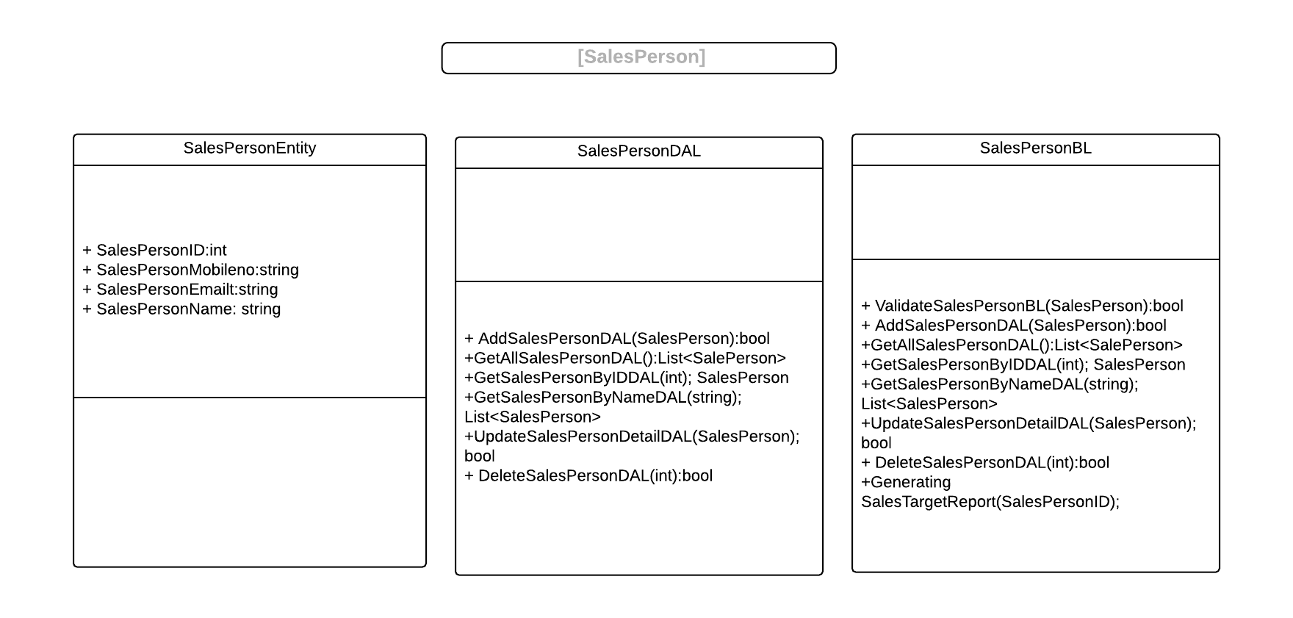
Class Diagram

Slide 12
Thank you

